Slide 1

463.6.2 Trusted Computing
Computer Security II
CS463/ECE424
University of Illinois
Based on Slides by Stalling and Brown

Slide 2
Outline
Bell-LaPadula (BLP)
Biba
Clark-Wilson
Chinese Wall

Slide 3
Multilevel Security (MLS)
An MLS system
Has system resources (particularly stored information) at more than one security level (i.e., has different types of sensitive resources) and
permits concurrent access by users who differ in security clearance and need-to-know, but
is able to prevent each user from accessing resources for which the user lacks authorization.
IETF RFC 2828
Notes:
Multilevel security is of interest when there is a requirement to maintain
a resource, such as a file system or database in which multiple levels of data
sensitivity are defined. The hierarchy could be as simple as two levels (e.g., public
and proprietary) or could have many levels (e.g., the military unclassified,
restricted, confidential, secret, top secret). The preceding three sections have
introduced us to the essential elements of multilevel security. In this section, we
look at two applications areas where MLS concepts have been applied: role-based
access control system and database security.

Slide 4
Bell-LaPadula (BLP) Model
Formal model for access control
  developed in 1970s
Subjects and objects are assigned a security class
  a subject has a security clearance
  an object has a security classification
  form a hierarchy and are referred to as security levels
    top secret > secret > confidential > restricted >unclassified
  security classes control the manner by which a subject may access an object
Notes:
The BLP model was developed in the 1970s as a formal model for access
control. The model relied on the access control concept described in Chapter 4
(e.g., Figure 4.4 ). In the model, each subject and each object is assigned a security
class . In the simplest formulation, security classes form a strict hierarchy and
are referred to as security levels . One example is the U.S. military classification
scheme:
top secret > secret > confidential > restricted > unclassified
It is possible to also add a set of categories or compartments to each security
level, so that a subject must be assigned both the appropriate level and category to
access an object. We ignore this refinement in the following discussion.
This concept is equally applicable in other areas, where information can be
organized into gross levels and categories and users can be granted clearances to
access certain categories of data. For example, the highest level of security might be
for strategic corporate planning documents and data, accessible by only corporate
officers and their staff; next might come sensitive financial and personnel data,
accessible only by administration personnel, corporate officers, and so on. This
suggests a classification scheme such as
strategic > sensitive > confidential > public
A subject is said to have a security clearance of a given level; an object is said to
have a security classification of a given level. The security classes control the manner
by which a subject may access an object.

Slide 5
BLP Model Access Modes
READ
  the subject is allowed only read access to the object
APPEND
  the subject is allowed only write access to the object
WRITE
  the subject is allowed both read and write access to the object
EXECUTE
  the subject is allowed neither read nor write access to the object but may invoke the object for execution
Notes:
The model defined four access modes,
although the authors pointed out that in specific implementation environments, a
different set of modes might be used. The modes are as follows:
• read: The subject is allowed only read access to the object.
• append: The subject is allowed only write access to the object.
• write: The subject is allowed both read and write access to the object.
• execute: The subject is allowed neither read nor write access to the object but
may invoke the object for execution.
When multiple categories or levels of data are defined, the requirement is
referred to as multilevel security . The general statement of the requirement for
confidentiality-centered multilevel security is that a subject at a high level may not
convey information to a subject at a lower level unless that flow accurately reflects
the will of an authorized user as revealed by an authorized declassification. For
implementation purposes, this requirement is in two parts and is simply stated.
A multilevel secure system for confidentiality must enforce the following:
• No read up: A subject can only read an object of less or equal security level.
This is referred to in the literature as the simple security property (ss-property) .
• No write down: A subject can only write into an object of greater or equal
security level. This is referred to in the literature as the *-property (pronounced
star property ).

Slide 6
No Read Up and No Write Down
No read up
  subject can only read an object of less or equal security level
  referred to as the simple security property (ss-property)
No write down
  a subject can only write into an object of greater or equal security level
  referred to as the *-property

Slide 7
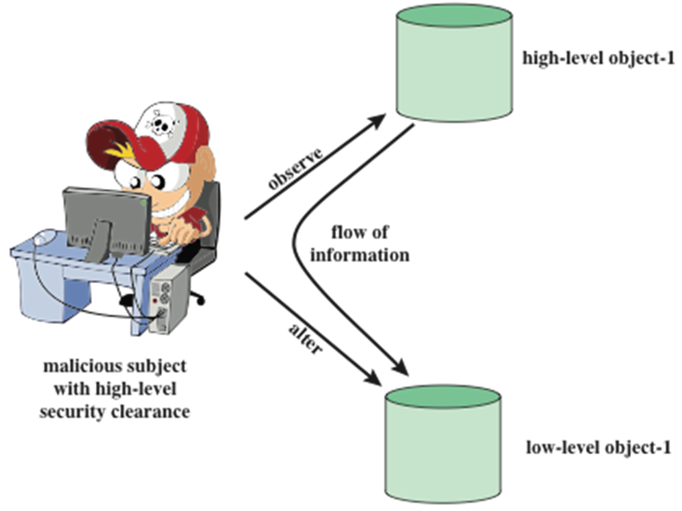
Threat Intuition
Notes:
Figure 13.1 illustrates the need for the *-property. Here, a malicious subject
passes classified information along by putting it into an information container
labeled at a lower security classification than the information itself. This will allow a
subsequent read access to this information by a subject at the lower clearance level.
These two properties provide the confidentiality form of what is known as
mandatory access control (MAC). Under this MAC, no access is allowed that does
not satisfy these two properties. In addition, the BLP model makes a provision for
discretionary access control (DAC).

Slide 8
Discretionary Control
An individual (or role) may grant to another individual (or role) access to a document
  based on the owner’s discretion, but
  these are constrained by the MAC rules
site policy overrides any discretionary access controls
This is called the ds-property
Notes:
• ds-property : An individual (or role) may grant to another individual (or role)
access to a document based on the owner’s discretion, constrained by the MAC
rules. Thus, a subject can exercise only accesses for which it has the necessary
authorization and which satisfy the MAC rules.
The basic idea is that site policy overrides any discretionary access controls.
That is, a user cannot give away data to unauthorized persons.

Slide 9
BLP Formal Description
Current state of system: (b, M, f, H)
  current access set b: triples of (s, o, a)
    subject s has current access to object o in access mode a
  access matrix M: matrix of M_{ij}
    access modes of subject S_{i} to access object O_{j}
  level function f: security level of subjects and objects
    f_{o} ( O_{j} ) is the classification level of object O_{j}
    f_{s} ( S_{i} ) is the security clearance of subject S_{i}
    f_{c} ( S_{i} ) is the current security level of subject S_{i}
  hierarchy H: a directed rooted tree of objects
Notes:
We use the notation presented in [BELL75]. The model is based on the concept of a
current state of the system. The state is described by the 4-tuple ( b , M , f , H ), defined
as follows:
• Current access set b : This is a set of triples of the form (subject, object, access-mode). A triple ( s , o , a ) means that subject s has current access to o in access mode a . Note that this does not simply mean that s has the access right a to o . The triple means that s is currently exercising that access right; that is s is currently accessing o by mode a .
• Access matrix M
The matrix element M _{ij} records the access modes in which subject S _{i} is permitted
to access object O _{j} .
• Level function f : This function assigns a security level to each subject and
object. It consists of three mappings: f _{o} ( O _{j} ) is the classification level of object
O _{j} and f _{s} ( S _{i} ) is the security clearance of subject S _{i} and f _{c} ( S _{i} ) is the current security level of subject S _{i} . The security clearance of a subject is the maximum security level of the subject. The subject may operate at this level or at a lower level. Thus, a user may log onto the system at a level lower than the user’s security clearance. This is particularly useful in a role-based access control system.
• Hierarchy H : This is a directed rooted tree whose nodes correspond to objects
in the system. The model requires that the security level of an object must
dominate the security level of its parent. For our discussion, we may equate
this with the condition that the security level of an object must be greater than
or equal to its parent.

Slide 10
BLP Formal Description
the three BLP properties:
  ss-property: every (S_{i}, O_{j}, read) has f_{c} (S_{i}) ≥ f_{o} (O_{j})
  *-property: every (S_{i}, O_{j}, append) has f_{c} (S_{i}) ≤ f_{o} (O_{j}) and
  every (S_{i}, O_{j}, write) has f_{c} (S_{i}) = f_{o} (O_{j})
  ds-property: every (S_{i}, O_{j}, A_{x}) has A_{x} ∈ Mij
These are used to define the concepts of secure state and secure system.
Notes:
We can now define the three BLP properties more formally. For every subject
S _{i} and every object O _{j} , the requirements can be stated as follows:
• ss-property: Every triple of the form ( S _{i} , O _{j} , read) in the current access set b
has the property f_{c}(S_{i}) ≥ f_{o}(O_{j}) .
• *-property: Every triple of the form ( S _{i} , O _{j} , append) in the current access set b has the property f_{c}(S_{i}) ≤ f_{o}(O_{j}) . Every triple of the form ( S _{i} , O _{j} , write) in the
current access set b has the property f _{c} ( S _{i} ) ≤ f _{o} ( O _{j} ).
• ds-property: If ( S _{i} , O _{j} , A _{x} ) is a current access (is in b ), then access mode A _{x}
is recorded in the ( S _{i} , O _{j} ) element of M . That is, ( S _{i} , O _{j} , A _{x} ) implies that
A_{x} ∈ M[S_{i},O_{j}] .

Slide 11
BLP Secure System
The state (b, M, f ,H) is secure if every element of b satisfies the three properties.
A system defines a set of transitions that allow changes to the four components of the system, (b, M, f, H).
A system is secure if system transitions on secure states result only in secure states.
Notes:
[BELL75] shows how these three points can be expressed as theorems using the
formal model. Further, given an actual design or implementation, it is theoretically
possible to prove the system secure by proving that any action that affects the state
of the system satisfies the three properties. In practice, for a complex system, such
a proof has never been fully developed. However, as mentioned earlier, the formal
statement of requirements can lead to a more secure design and implementation.

Slide 12
Illustration
o₅
High
Append
Write
s₂
o₄
Read
o₅
Object
Read
o₃
s₂
Subject
Append
Write
s₁
o₂
Read
Read
o₁
Low

Slide 13
BLP Transition Rules
1. Get access: Add a triple (subject, object, access-mode) to the current access set b.
2. Release access: Remove a triple (subject , object , access-mode) from the current access set b.
3. Change object level: Change the value of f_{o}(O_{j}) for some object O_{j}.
4. Change current level: Change the value of f_{c}(S_{i}) for some subject S_{i}.
5. Give access permission: Add an access mode to some entry of the access permission matrix M.
6. Rescind access permission: Delete an access mode from some entry of M.
7. Create an object: Attach an object to the current tree structure H as a leaf.
8. Delete a group of objects: Detach from H an object and all other objects beneath it in the hierarchy. This renders the group of objects inactive.
Notes:
The BLP model includes a set of rules based on abstract operations that change the
state of the system. The rules are as follows:
1. Get access: Add a triple ( subject , object , access-mode ) to the current access set b .
Used by a subject to initiate access to an object in the requested mode.
2. Release access: Remove a triple ( subject , object , access-mode ) from the current
access set b . Used to release previously initiated access.
3. Change object level: Change the value of f _{o} ( O _{j} ) for some object O _{j} . Used by a
subject to alter the security level of an object.
4. Change current level: Change the value of f _{c} ( S _{i} ) for some subject S _{i} . Used by a
subject to alter the security level of a subject.
5. Give access permission: Add an access mode to some entry of the access
permission matrix M . Used by a subject to grant an access mode on a specified
object to another subject.
6. Rescind access permission: Delete an access mode from some entry of M .
Used by a subject to revoke an access previously granted.
7. Create an object: Attach an object to the current tree structure H as a leaf.
Used to create a new object or activate an object that has previously been
defined but is inactive because it has not been inserted into H .
8. Delete a group of objects: Detach from H an object and all other objects
beneath it in the hierarchy. This renders the group of objects inactive. This
operation may also modify the current access set b because all accesses to the
object are released.
Rules 1 and 2 alter the current access; rules 3 and 4 alter the level functions;
rules 5 and 6 alter access permission; and rules 7 and 8 alter the hierarchy. Each rule
is governed by the application of the three properties. For example, for get access
for a read, we must have f_{c}(S_{i}) ≥ f_{o}(O_{j}) and A, ε M[S_{i},O_{j}] .

Slide 14
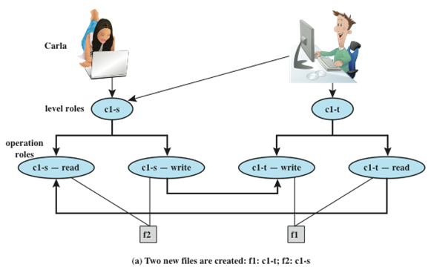
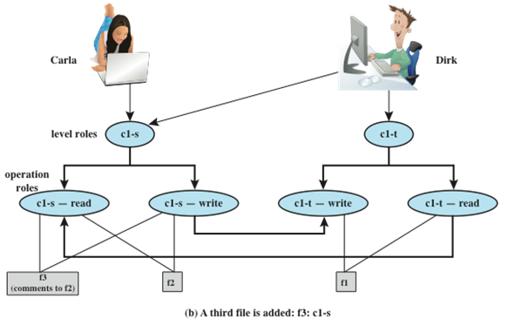
BLP Example
Dirk
BLP Example
*-property
Notes:
An example, from [WEIP06] illustrates the operation of the BLP model and also
highlights a practical issue that must be addressed. We assume a role-based access
control system. Carla and Dirk are users of the system. Carla is a student (s) in
course c1. Dirk is a teacher (t) in course c1 but may also access the system as a
student; thus two roles are assigned to Dirk:
Carla: (c1-s)
Dirk: (c1-t), (c1-s)
The student role is assigned a lower security clearance and the teacher role a
higher security clearance. Let us look at some possible actions:
1. Dirk creates a new file f1 as c1-t; Carla creates file f2 as c1-s ( Figure 13.2a ).
Carla can read and write to f2, but cannot read f1, because it is at a higher
classification level (teacher level). In the c1-t role, Dirk can read and write f1
and can read f2 if Carla grants access to f2. However, in this role, Dirk cannot
write f2 because of the *-property; neither Dirk nor a Trojan horse on his
behalf can downgrade data from the teacher level to the student level. Only if
Dirk logs in as a student can he create a c1-s file or write to an existing c1-s file,
such as f2. In the student role, Dirk can also read f2.
2. Dirk reads f2 and wants to create a new file with comments to Carla as feedback.
Dirk must sign in student role c1-s to create f3 so that it can be accessed
by Carla ( Figure 13.2b ). In a teacher role, Dirk cannot create a file at a student
classification level.

Slide 15
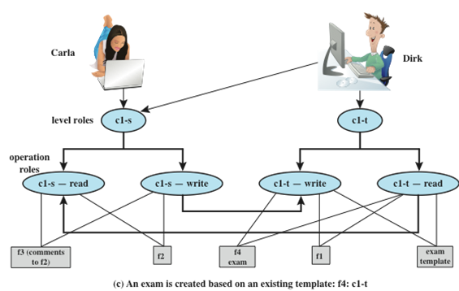
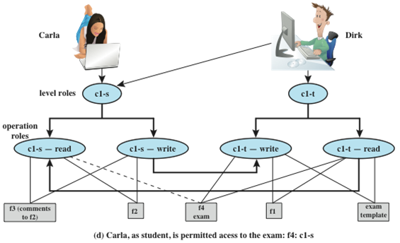
BLP Example
ss-property and *-property
Notes:
Dirk creates an exam based on an existing template file store at level c1-t.
Dirk must log in as c1-t to read the template and the file he creates (f4) must
also be at the teacher level ( Figure 13.2c ).
4. Dirk wants Carla to take the exam and so must provide her with read access.
However, such access would violate the ss-property. Dirk must downgrade
the classification of f4 from c1-t to c1-s. Dirk cannot do this in the c1-t role
because this would violate the *-property. Therefore, a security administrator
(possibly Dirk in this role) must have downgrade authority and must be able to perform the
downgrade outside the BLP model. The dotted line in
Figure 13.2d connecting f4 with c1-s-read indicates that this connection has
not been generated by the default BLP rules but by a system operation.

Slide 16
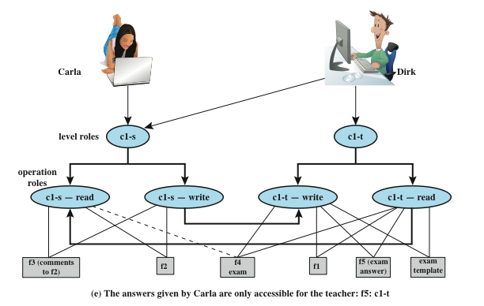
BLP Example
“downgrade” in a controlled and monitored manner
“classification creep”: information from a range of sources and levels
Integrity ?
“covert channels”: (untrusted) low classified executable data
allowed to be executed by a high clearance (trusted) subject
Notes:
5. Carla writes the answers to the exam into a file f5. She creates the file at
level c1-t so that only Dirk can read the file. This is an example of writing up,
which is not forbidden by the BLP rules. Carla can still see her answers at her
workstation but cannot access f5 for reading.
This discussion illustrates some critical practical limitations of the BLP
model. First, as noted in step 4, the BLP model has no provision to manage the
“downgrade” of objects, even though the requirements for multilevel security
recognize that such a flow of information from a higher to a lower level may be
required, provided it reflects the will of an authorized user. Hence, any practical
implementation of a multilevel system has to support such a process in a controlled
and monitored manner. Related to this is another concern. A subject constrained
by the BLP model can only be “editing” (reading and writing) a file at one security
level while also viewing files at the same or lower levels. If the new document
consolidates information from a range of sources and levels, some of that information
is now classified at a higher level than it was originally. This is known as classification
creep and is a well-known concern when managing multilevel information.
Again, some process of managed downgrading of information is needed to restore
reasonable classification levels.

Slide 17
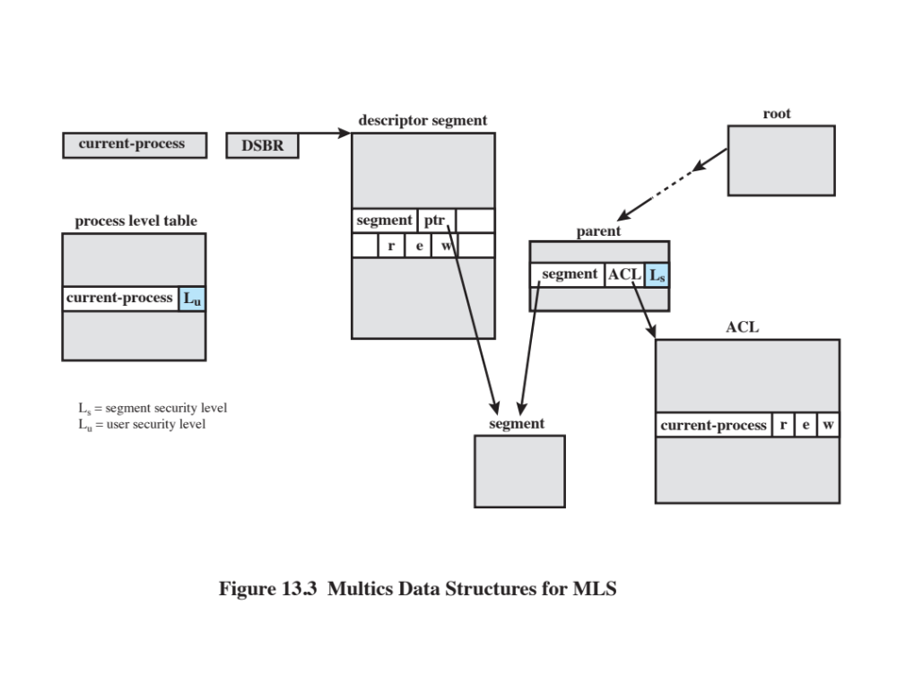
BLP in Multics OS
Notes:
[BELL75] outlines an implementation of MLS on the Multics operating system. We
begin with a brief description of the relevant aspects of Multics.
Multics is a time-sharing operating system that was developed by a group
at MIT known as Project MAC (multiple-access computers) in the 1960s. Multics
was not just years but decades ahead of its time. Even by the mid-1980s, almost
20 years after it became operational, Multics had superior security features and
greater sophistication in the user interface and other areas than other contemporary
mainframe operating systems.
Both memory management and the file system in Multics are based on the
concept of segments. Virtual memory is segmented. For most hardware platforms,
paging is also used. In any case, the working space of a process is assigned to a segment
and a process may create one or more data segments for use during execution. Each
file in the file system is defined as a segment. Thus, the OS uses the same mechanism
to load a data segment from virtual memory into main memory and to load a file
from virtual memory into main memory. Segments are arranged hierarchically, from
a root directory down to individual segments.
Multics manages the virtual address space by means of a descriptor segment,
which is associated with a process and which has one entry for each segment in virtual
memory accessible by this process. The descriptor segment base register points to
the start of the descriptor segment for the process that is currently executing. The
descriptor entry includes a pointer to the start of the segment in virtual memory
plus protection information, in the form of read, write, and execute bits, which may
be individually set to ON or OFF. The protection information found in a segment’s
descriptor is derived from the access control list for the segment.
For MLS, two additional features are required. A process-level table includes
an entry of each active process, and the entry indicates the security clearance of
the process. Associated with each segment is a security level, which is stored in the
parent directory segment of the segment in question.
Corresponding to the security state of the BLP model ( b , M , f , H ) is a set of
Multics data structures ( Figure 13.3 ). The correspondence is as follows:
b: Segment descriptor word. The descriptor segment identifies the subject
(process). The segment pointer in segment descriptor word identifies
the object (data segment). The three access control bits in the segment
descriptor word identify the access mode.
M: Access control list.
f: Information in the directory segment and in the process-level table.
H: Hierarchical segment structure.
With these data structures, Multics can enforce discretionary and mandatory
access control. When a process attempts an access to a segment, it must
have the desired access permission as specified by the access control list. Also,
its security clearance is compared to the security classification of the segment to
be accessed to determine if the simple security rule and *-property security rule
are satisfied.

Slide 18
Limitations to the BLP Model
BLP does not address integrity issues.
The *-property is difficult to implement
  Inferences from ordinary actions of higher-level subjects (side channels)
  Deliberate communications by higher-level subjects (covert channels)
The BLP formalism does not include de-classification protocols.
Notes:
While the BLP model could in theory lay the foundations for secure computing within
a single administration realm environment, there are some important limitations
to its usability and difficulties to its implementation.
First, there is the incompatibility of confidentiality and integrity within a single
MLS system. In general terms, MLS can work either for powers or for secrets , but not
readily for both. This mutual exclusion excludes some interesting power and integrity
centered technologies from being used effectively in BLP style MLS environments.
A second important limitations to usability is the so called cooperating conspirator
problem in the presence of covert channels. In the presence of shared resources the
*-property may become unenforceable. This is especially a problem in the presence
of active content that is prevalent in current word processing and other document
formats. A malicious document could carry in it a subject that would when executed
broadcast classified documents using shared-resource covert channels. In essence, the
BLP model effectively breaks down when (untrusted) low classified executable data
are allowed to be executed by a high clearance (trusted) subject.

Slide 19


Slide 20
Biba Integrity Model: Actions
Modify: To write or update information in an object
Observe: To read information in an object
Execute: To execute an object
Invoke: Communication from one subject to another
Notes:
The BLP model deals with confidentiality and is concerned with unauthorized
disclosure of information. The Biba [BIBA77] models deals with integrity and is concerned
with the unauthorized modification of data. The Biba model is intended to
deal with the case in which there is data that must be visible to users at multiple or all
security levels but should only be modified in controlled ways by authorized agents.
The basic elements of the Biba model have the same structure as the BLP
model. and I ( O ) As with BLP, the Biba model deals with subjects and objects. Each subject
and object is assigned an integrity level, denoted as I( S ) for subject S and
object O , respectively. A simple hierarchical classification can be used, in which there
is a strict ordering of levels from lowest to highest. As in the BLP model, it is also
possible to add a set of categories to the classification scheme; this we ignore here.
The model considers the following access modes:
• Modify: To write or update information in an object
• Observe: To read information in an object
• Execute: To execute an object
• Invoke: Communication from one subject to another
The first three modes are analogous to BLP access modes. The invoke mode is
new. Biba then proposes a number of alternative policies that can be imposed on this
model. The most relevant is the strict integrity policy, based on the following rules:
• Simple integrity: A subject can modify an object only if the integrity level of
the subject dominates the integrity level of the object: I( S ) ≥ I( O ).
• Integrity confinement: A subject can read an object only if the integrity level
of the subject is dominated by the integrity level of the object: I( S ) ≤ I( O ).
• Invocation property: A subject can invoke another subject only if the integrity
level of the first subject dominates the integrity level of the second subject:
I( S ₁ ) ≥ I( S ₂ ).
The first two rules are analogous to those of the BLP model but are concerned
with integrity and reverse the significance of read and write. The simple integrity rule
is the logical write-up restriction that prevents contamination of high-integrity data.
Figure 13.4 illustrates the need for the integrity confinement rule. A low-integrity
process may read low-integrity data but is prevented from contaminating a high integrity
file with that data by the simple integrity rule. If only this rule is in force, a
high-integrity process could conceivably copy low-integrity data into a high-integrity
file. Normally, one would trust a high-integrity process to not contaminate a high integrity
file, but either an error in the process code or a Trojan horse could result in
such contamination; hence the need for the integrity confinement rule.

Slide 21
Biba Integrity Model: Rules
Simple integrity: A subject can modify an object only if the integrity level of the subject dominates the integrity level of the object: I( S ) ≥ I( O ).
Integrity confinement: A subject can read an object only if the integrity level of the subject is dominated by the integrity level of the object: I( S ) ≤ I( O ).
Invocation property: A subject can invoke another subject only if the integrity level of the first subject dominates the integrity level of the second subject:
I( S1 ) ≥ I( S2 ).

Slide 22
Clark-Wilson Integrity Model
Models commercial operations
  Well-formed transactions
    A user should not manipulate data arbitrarily
  Separation of duty among users
    A person who creates or certifies a well-formed transaction is not allowed to execute it
Aims to model two key concepts from common commercial practice
  Well-formed objects and transactions
  Separation of duty between users
Notes:
A more elaborate and perhaps more practical integrity model was proposed by Clark
and Wilson [CLAR87]. The Clark-Wilson model (CWM) is aimed at commercial
rather than military applications and closely models real commercial operations. The
model is based on two concepts that are traditionally used to enforce commercial
security policies:
• Well-formed transactions: A user should not manipulate data arbitrarily, but
only in constrained ways that preserve or ensure the integrity of the data.
• Separation of duty among users: Any person permitted to create or certify a
well-formed transaction may not be permitted to execute it (at least against
production data).

Slide 23
Clark-Wilson Concepts
Constrained data items (CDIs)
  Subject to strict integrity controls
Unconstrained data items (UDIs)
  Unchecked data items
Integrity verification procedures (IVPs):
  Intended to assure that all CDIs conform to some application-specific model of integrity and consistency
Transformation procedures (TPs):
  System transactions that change the set of CDIs from one consistent state to another
Notes:
The model imposes integrity controls on data and the transactions that
manipulate the data. The principal components of the model are as follows:
• Constrained data items (CDIs): Subject to strict integrity controls.
• Unconstrained data items (UDIs): Unchecked data items. An example is a
simple text file.
• Integrity verification procedures (IVPs): Intended to assure that all CDIs
conform to some application-specific model of integrity and consistency.
• Transformation procedures (TPs): System transactions that change the set of
CDIs from one consistent state to another.

Slide 24
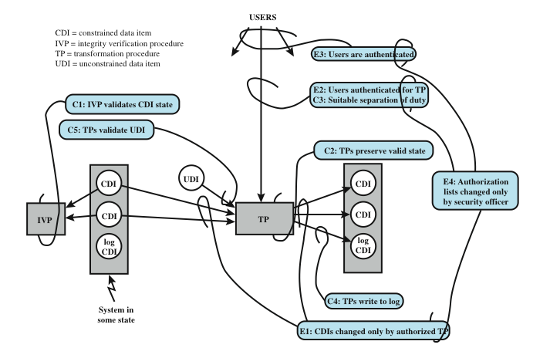
Clark-Wilson Integrity Model
Notes:
The CWM enforces integrity by means of certification and enforcement rules
on TPs. Certification rules are security policy restrictions on the behavior of IVPs
and TPs. Enforcement rules are built-in system security mechanisms that achieve
the objectives of the certification rules. The rules are as follows:
Cl: All IVPs must properly ensure that all CDIs are in a valid state at the time
the IVP is run.
C2: All TPs must be certified to be valid. That is, they must take a CDI to a valid
final state, given that it is in a valid state to begin with. For each TP, and
each set of CDIs that it may manipulate, the security officer must specify a
relation, which defines that execution. A relation is thus of the form (TPi,
(CDIa, CDIb, CDIc . . . )), where the list of CDIs defines a particular set of
arguments for which the TP has been certified.
El: The system must maintain the list of relations specified in rule C2 and
must ensure that the only manipulation of any CDI is by a TP, where the
TP is operating on the CDI as specified in some relation.
E2: The system must maintain a list of relations of the form (UserID, TPi,
(CDIa, CDIb, CDIc, . . . )), which relates a user, a TP, and the data objects
that TP may reference on behalf of that user. It must ensure that only
executions described in one of the relations are performed.
C3: The list of relations in E2 must be certified to meet the separation of duty
requirement.
E3: The system must authenticate the identity of each user attempting to
execute a TP.
C4: All TPs must be certified to write to an append-only CDI (the log) all information
necessary to permit the nature of the operation to be reconstructed.
C5: Any TP that takes a UDI as an input value must be certified to perform
only valid transformations, or else no transformations, for any possible
value of the UDI. The transformation should take the input from a UDI
to a CDI, or the UDI is rejected. Typically, this is an edit program.
E4: Only the agent permitted to certify entities may change the list of such
entities associated with other entities: specifically, the list of TPs associated
with a CDI and the list of users associated with a TP. An agent that can
certify an entity may not have any execute rights with respect to that entity.
Figure 13.5 illustrates the rules. The rules combine to form a two-part integrity
assurance facility, in which certification is done by a security officer with respect to
an integrity policy, and enforcement is done by the system.

Slide 25
Chinese Wall Model
Use discretionary and mandatory access to address integrity and confidentiality concerns
  Subjects: Active entities that may wish to access protected objects
  Information: Information organized into a hierarchy
    Objects: Individual items of information, each concerning a single corporation
    Dataset (DS): All objects that concern the same corporation
    Conflict of interest (CI) class: All datasets whose corporations are in competition
  Access rules: Rules for read and write access
Notes:
The Chinese Wall Model (CWM) takes a quite different approach to specifying
integrity and confidentiality than any of the approaches we have examined so far.
The model was developed for commercial applications in which conflicts of interest
can arise. The model makes use of both discretionary and mandatory access concepts.
The principal idea behind the CWM is a concept that is common in the financial
and legal professions, which is to use a what is referred to as a Chinese wall to prevent
a conflict of interest. An example from the financial world is that of a market analyst
working for a financial institution providing corporate business services. An analyst
cannot be allowed to provide advice to one company when the analyst has confidential
information (insider knowledge) about the plans or status of a competitor. However,
the analyst is free to advise multiple corporations that are not in competition with
each other and to draw on market information that is open to the public.
The elements of the model are the following:
• Subjects: Active entities that may wish to access protected objects; includes
users and processes
• Information: Corporate information organized into a hierarchy with three levels:
— Objects: Individual items of information, each concerning a single
corporation
— Dataset (DS): All objects that concern the same corporation
— Conflict of interest (CI) class: All datasets whose corporations are in
competition
• Access rules: Rules for read and write access

Slide 26
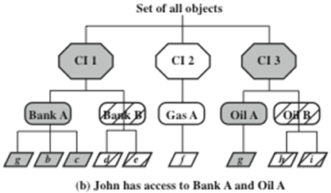
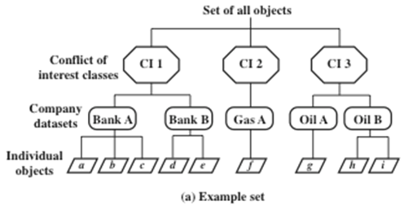
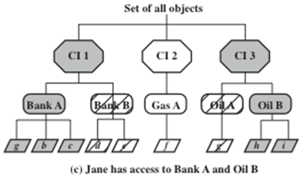
Chinese Wall Model
Simple security rule: S can read O only if
• O is in the same DS as an object already accessed by S, OR
• O belongs to a CI from which S has not yet accessed any information
*-property rule: S can write O only if
• S can read O according to the simple security rule, AND
• All objects that S can read are in the same DS as O.
sanitized data
Notes:
Figure 13.6a gives an example. There are datasets representing banks, oil
companies, and gas companies. All bank datasets are in one CI, all oil company
datasets in another CI, and so forth.
In contrast to the models we have studies so far, the CWM does not assign security
levels to subjects and objects and is thus not a true multilevel secure model. Instead, the
history of a subject’s previous access determines access control. The basis of the Chinese
wall policy is that subjects are only allowed access to information that is not held to conflict
with any other information that they already possess. Once a subject accesses information
from one dataset, a wall is set up to protect information in other datasets in the same CI.
The subject can access information on one side of the wall but not the other side. Further,
information in other CIs is initially not considered to be on one side or the other of the
wall but out in the open. When additional accesses are made in other CIs by the same
subject, the shape of the wall changes to maintain the desired protection. Further, each
subject is controlled by his or her own wall—the walls for different subjects are different.
To enforce the Chinese wall policy, two rules are needed. To indicate the similarity
with the two BLP rules, the authors gave them the same names. The first rule
is the simple security rule:
Simple security rule: A subject S can read on object O only if
• O is in the same DS as an object already accessed by S, OR
• O belongs to a CI from which S has not yet accessed any information
Figures 13.6b and c illustrate the operation of this rule. Assume that at some
point, John has made his first read request to any object in this set for an object in
the Bank A DS. Because John has not previously accessed an object in any other
DS in CI 1, the access is granted. Further, the system must remember that access
has been granted so that any subsequent request for access to an object in the Bank
B DS will be denied. Any request for access to other objects in the Bank A DS is
granted. At a later time, John requests access to an object in the Oil A DS. Because
there is no conflict, this access is granted, but a wall is set up prohibiting subsequent
access to the Oil B DS. Similarly, Figure 13.6c reflects the access history of Jane.
The simple security rule does not prevent an indirect flow of information that
would cause a conflict of interest. In our example, John has access to Oil A DS and
Bank A DS; Jane has access to Oil B DS and Bank A DS. If John is allowed to read
from the Oil A DS and write into the Bank A DS, John may transfer information
about Oil A into the Bank A DS; this is indicated by changing the value of the first
object under the Bank A DS to g . The data can then subsequently be read by Jane.
Thus, Jane would have access to information about both Oil A and Oil B, creating
a conflict of interest. To prevent this, the CWM has a second rule:
*-property rule: A subject S can write an object O only if
• S can read O according to the simple security rule, AND
• All objects that S can read are in the same DS as O.
Put another way, either subject cannot write at all, or a subject’s access (both
read and write) is limited to a single dataset. Thus, in Figure 13.6 , neither John nor
Jane has write access to any objects in the overall universe of data.
The *-property rule is quite restrictive. However, in many cases, a user only
needs read access because the user is performing some analysis role.
To somewhat ease the write restriction, the model includes the concept
of sanitized data . In essence, sanitized data are data that may be derived from
corporate data but that cannot be used to discover the corporation’s identity. Any
DS consisting solely of sanitized data need not be protected by a wall; thus the two
CWM rules do not apply to such DSs.

Slide 28
Reading
Computer Security: Principles and Practice (2nd Edition), Stallings, Pearson HE, Inc. Chapter 13 Trusted Computing and Multilevel Security

Slide 29
Discussion
What might be the shape of the next generation of policy models?
  Don’t be evil?
Consider new applications and architectures
  Social media (Facebook v. Google+ etc.)
  Mobiles (laptops, tablets, smartphones) (BYOD etc.)
  Internet of Things (IoT)
  Clouds
  Crowdsourcing (Waze etc.)

